Slide 1
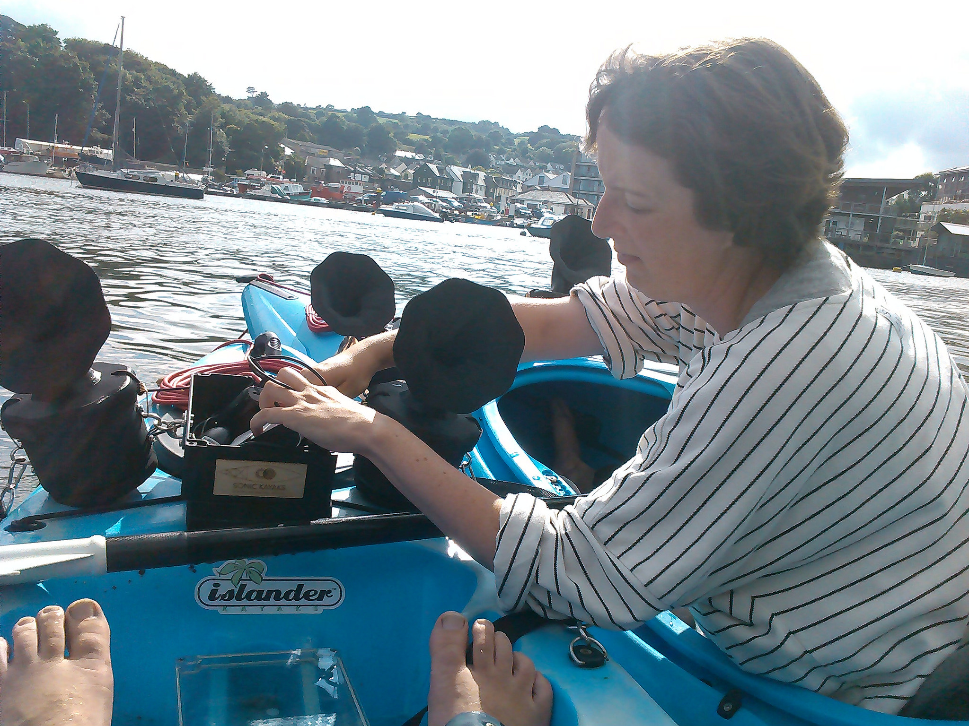
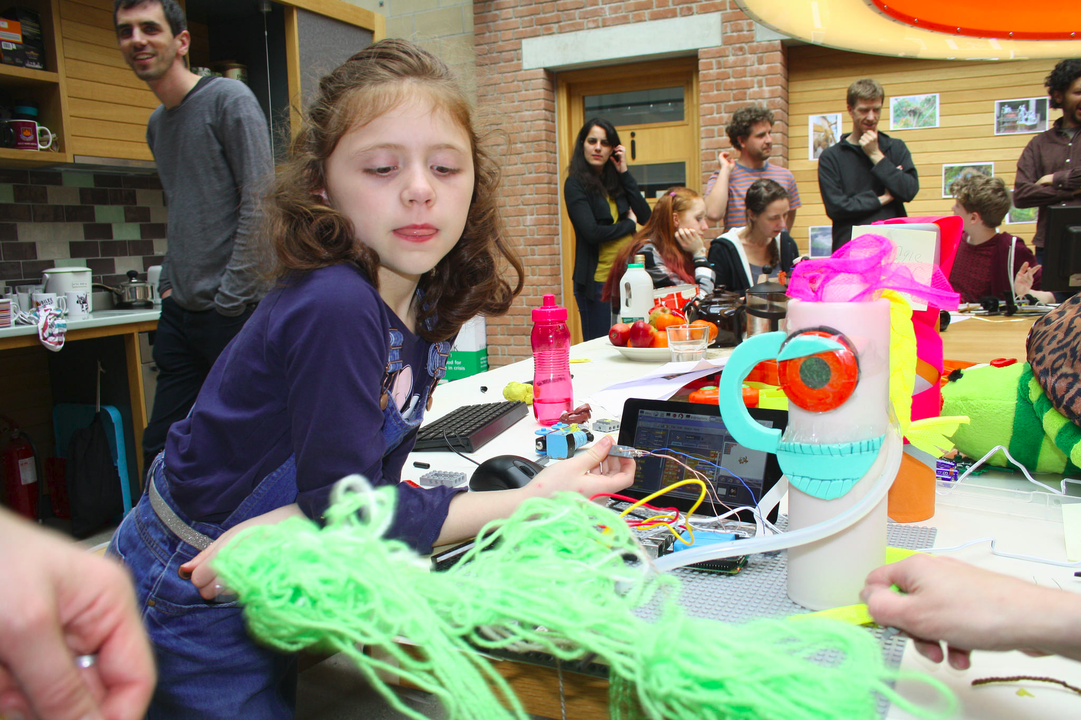
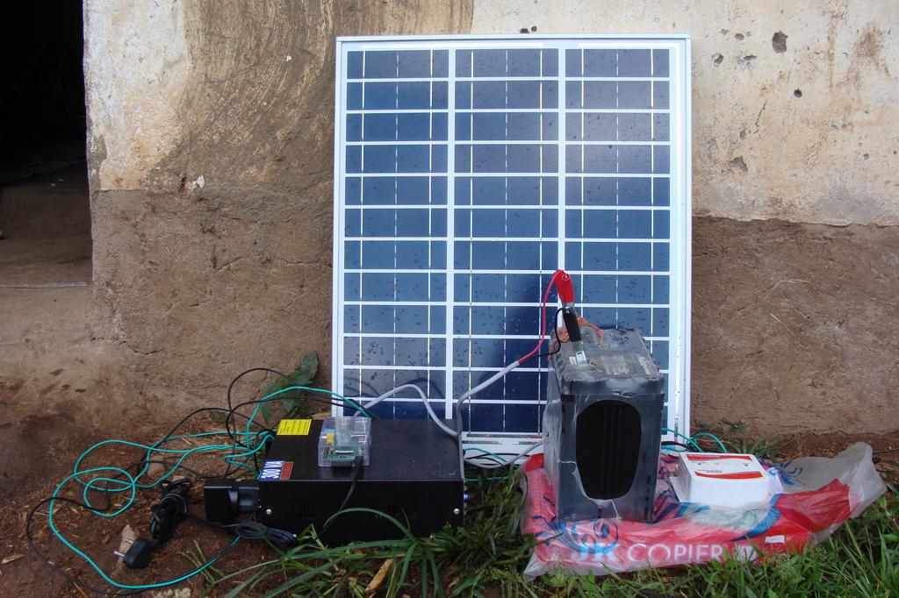

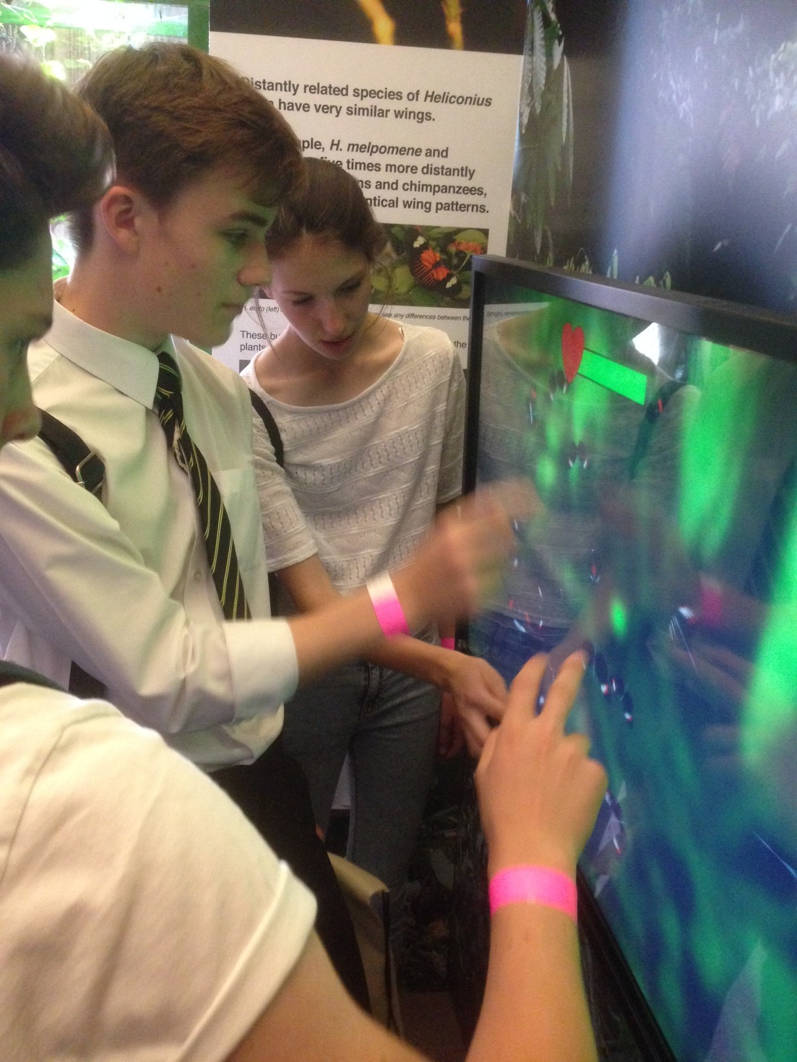
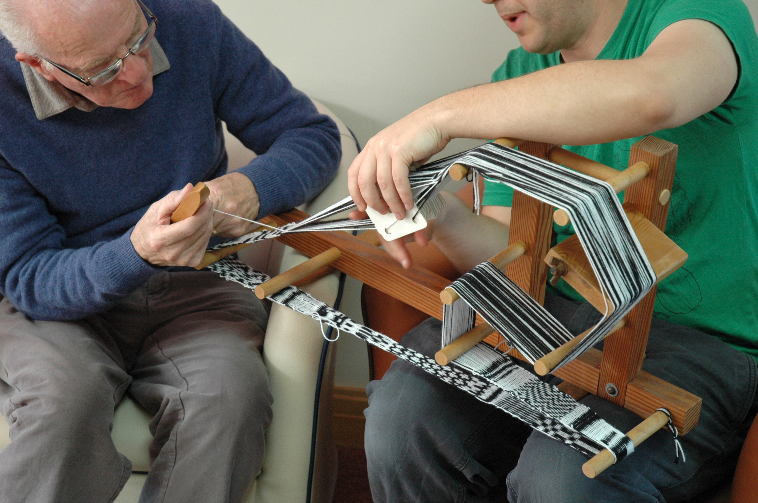

Slide 2
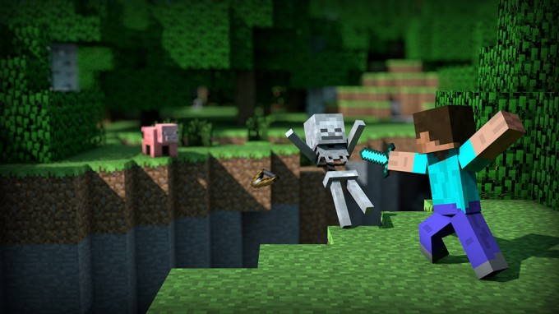


Get your lasers out of my garden
Playing with voxels: a 3d journey through urban green space forms
Karen Anderson, Stefano Casalegno, Steve Hancock
Dave Griffiths, Amber Griffiths

Slide 3
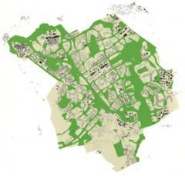
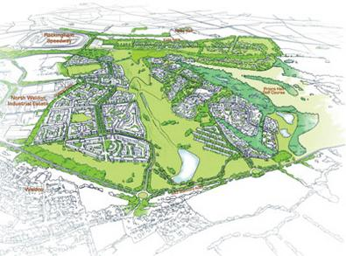
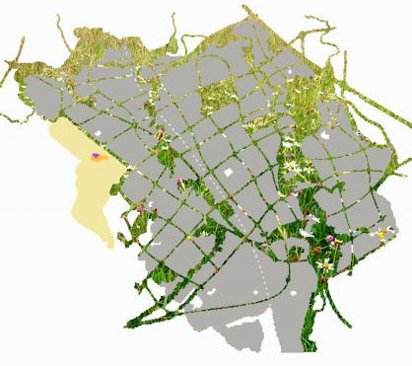
Models of urban greenspace
Urban greenspace is frequently examined as a 2D variable.

Slide 4
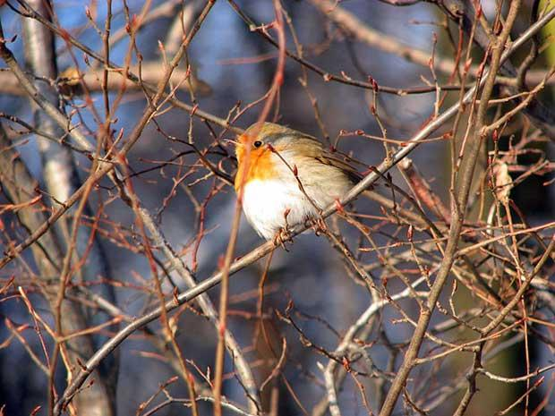
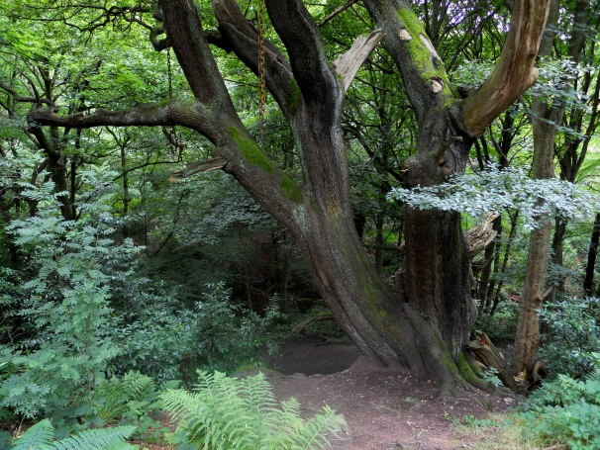

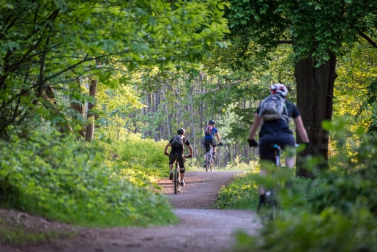
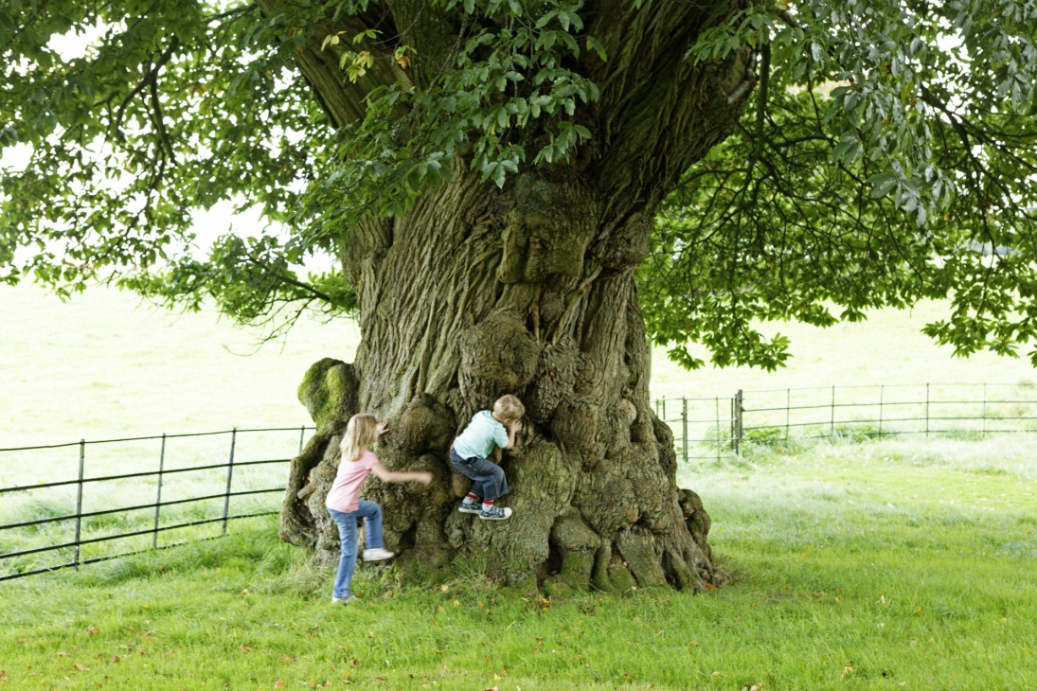
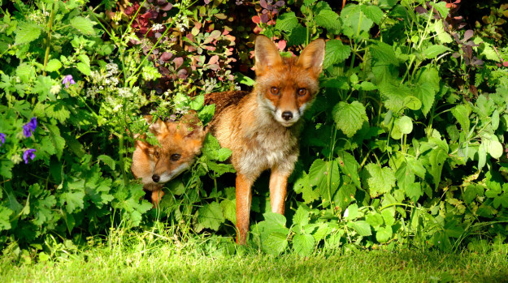
3D structure of greenspace = important
Quantifying the 3D and spatial structure of greenspace
→ understanding delivery of ecosystem services?

Slide 5
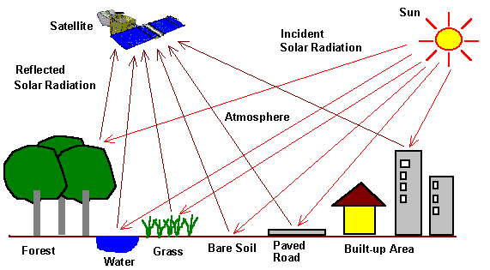
Remote sensing problem
Standard remote sensing approaches cannot measure the understorey. Only the ‘surface’ is recorded.
>> 2D urban greenspace models <<

Slide 6
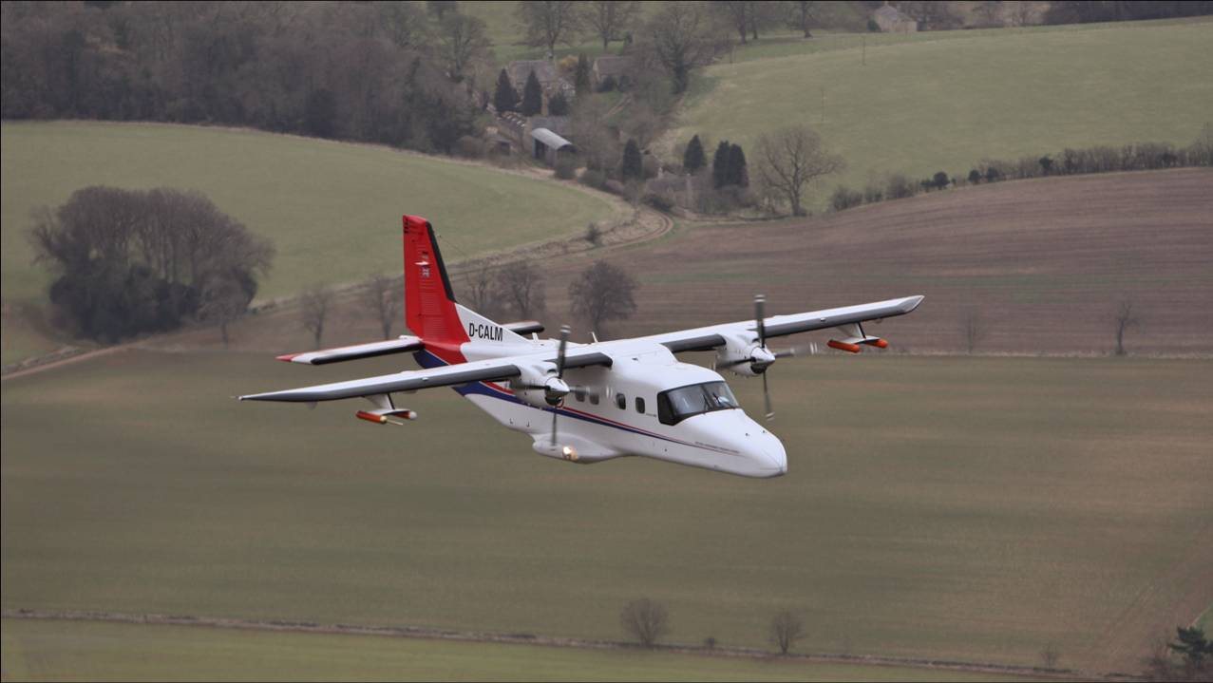
Lidar scanning: Bedford, Luton and Milton Keynes

Slide 7
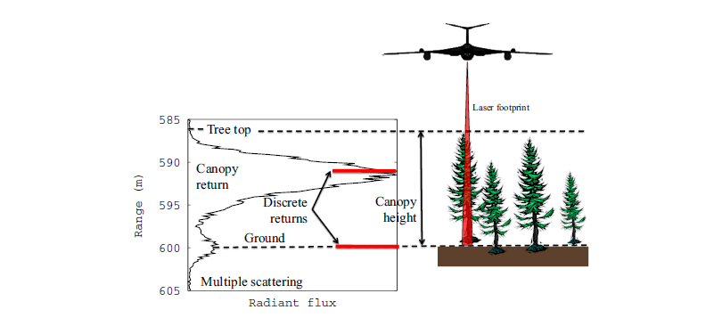
Waveform LiDAR is different
Waveform LiDAR measures the time-varying signal of the laser pulse as it illuminates different elements of the canopy.
>> information on 3D structure! <<

Slide 8


Signal processing
Notes:
This is the first paper produced which built on steve’s previous project expertise in processing and handling complex lidar data. Some of the airborne data for urban bess featured in this paper. It was the start of a detailed analysis of the vegetation structure of the cranfield triangle.
<number>

Slide 9
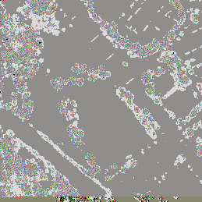
390m squares
Notes:
<number>

Slide 10

Notes:
<number>

Slide 11


Slide 12
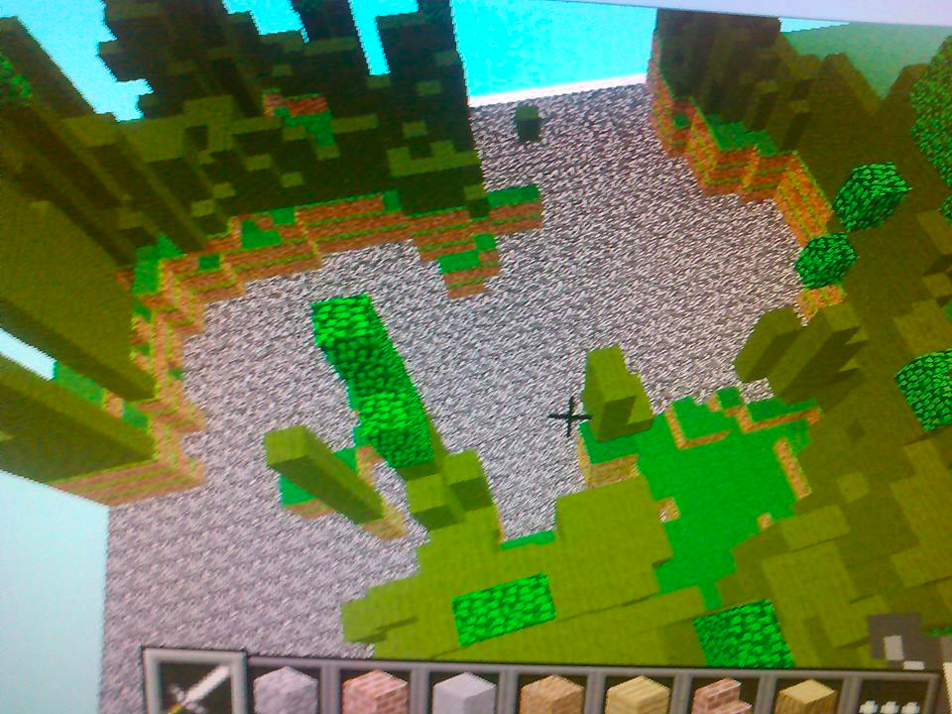
Notes:
<number>

Slide 13
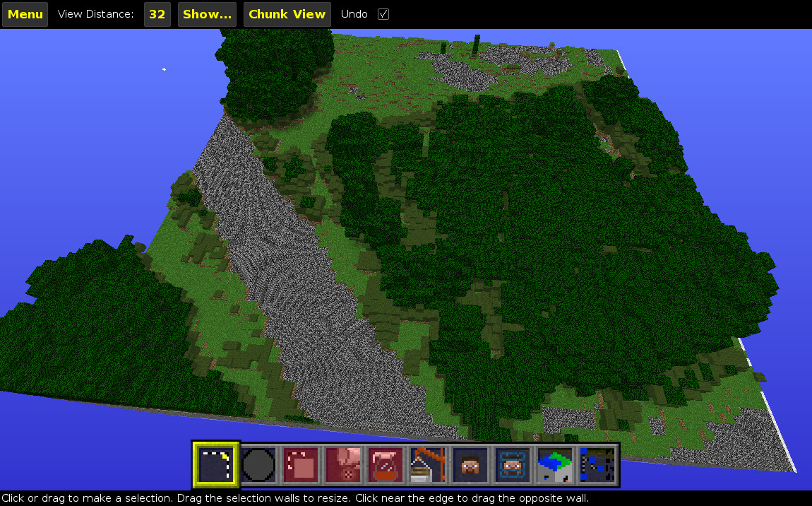
Notes:
<number>

Slide 14
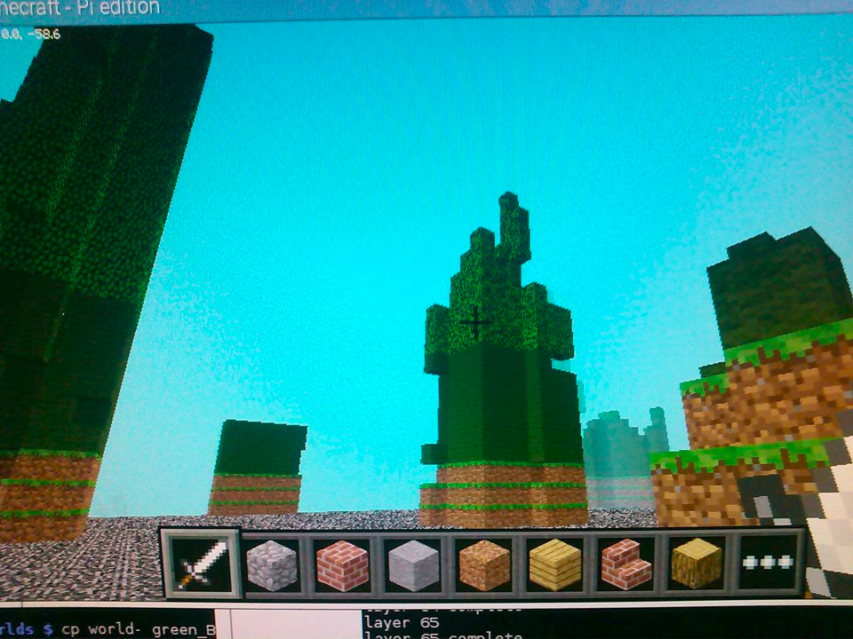
Notes:
<number>

Slide 15
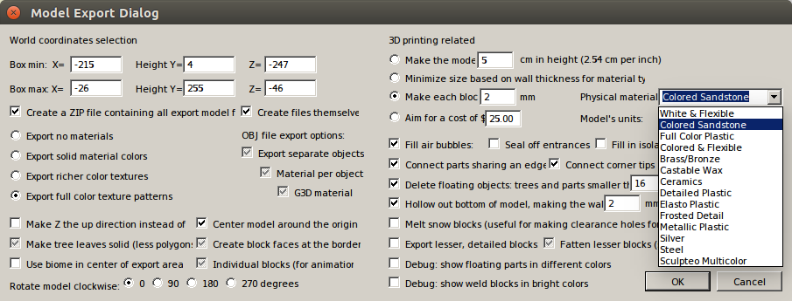
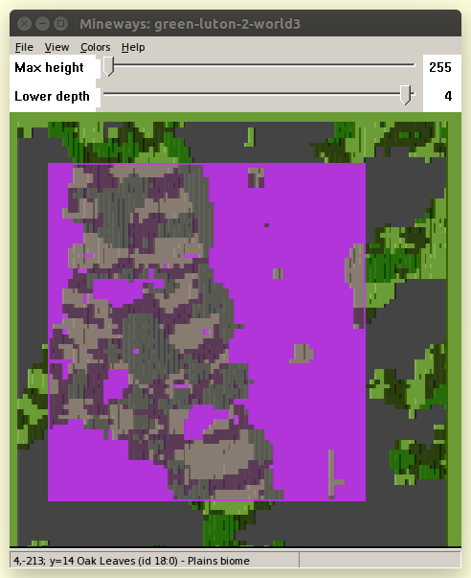
Mineways
Notes:
<number>

Slide 16
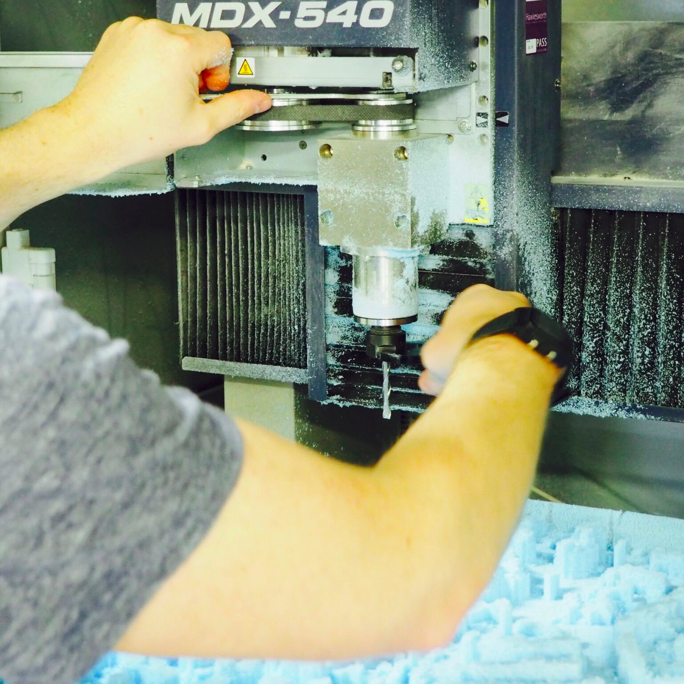
Jo McCallum
AHRC Studentship in Digital Craft Falmouth University
Notes:
<number>

Slide 17
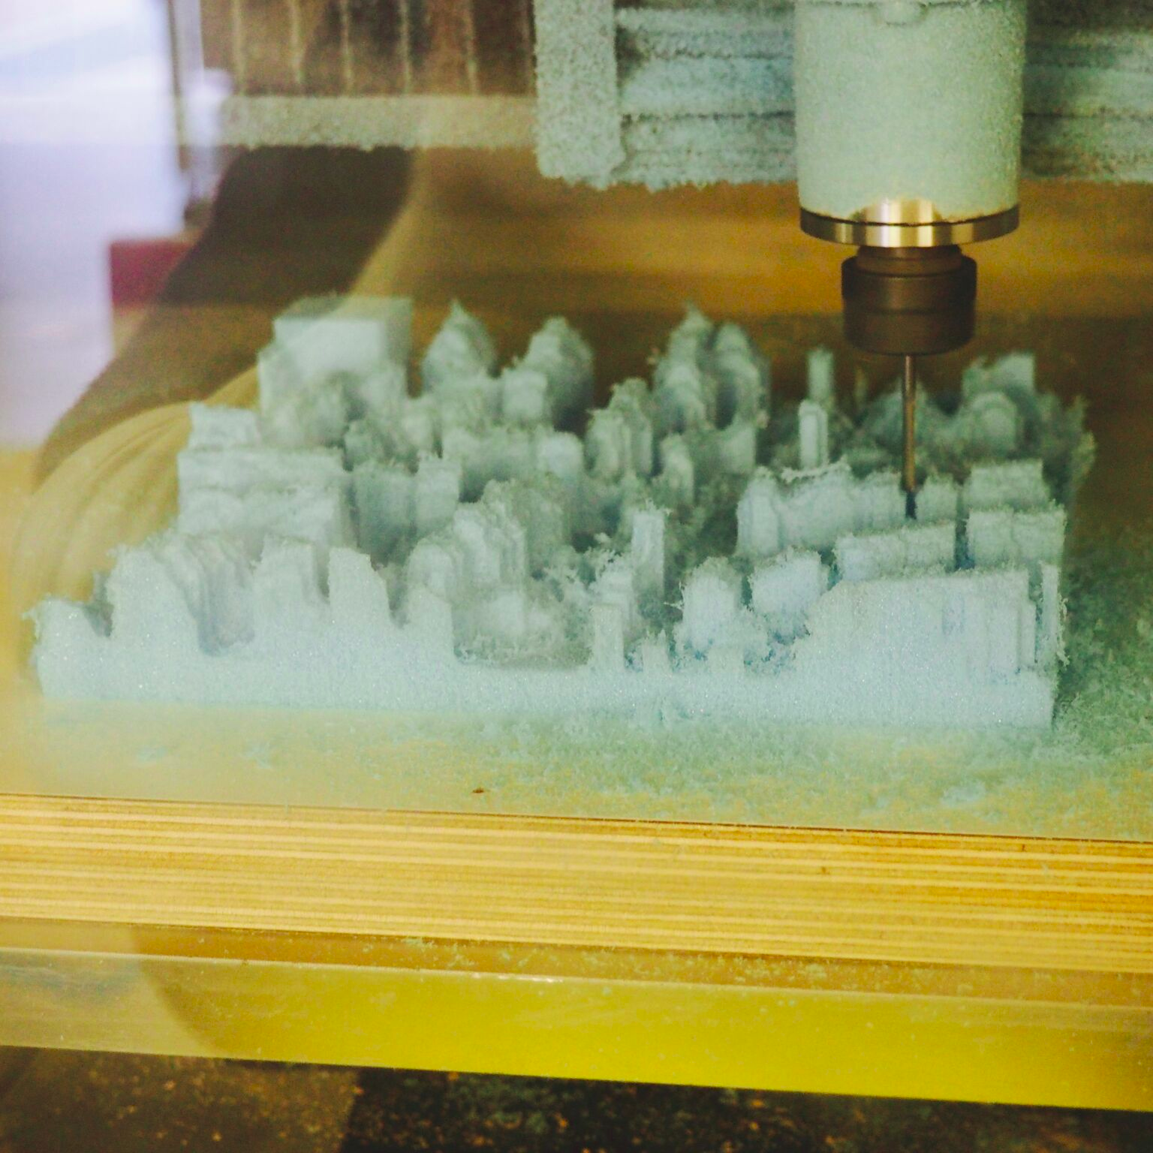
Notes:
<number>

Slide 18
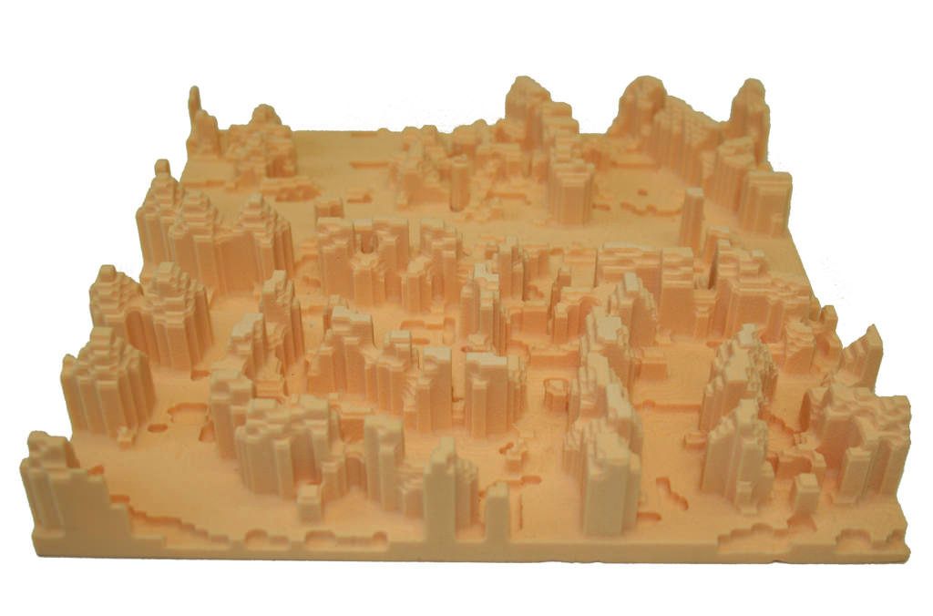
Notes:
<number>

Slide 19
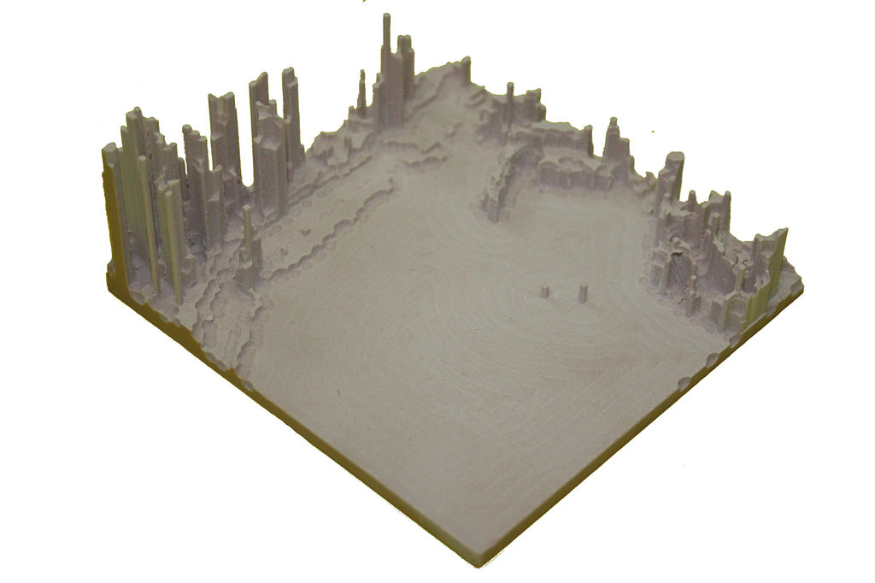
Notes:
<number>

Slide 20
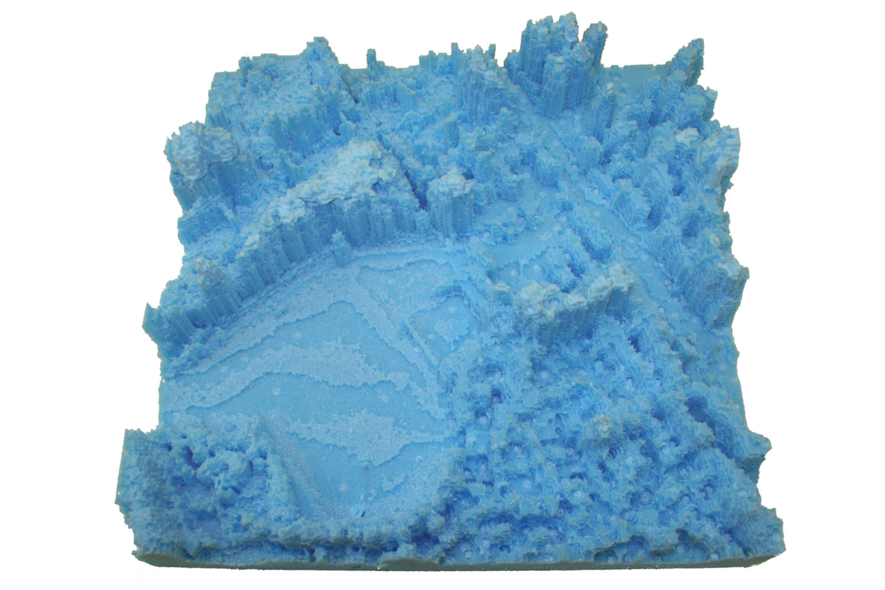
Notes:
<number>

Slide 21
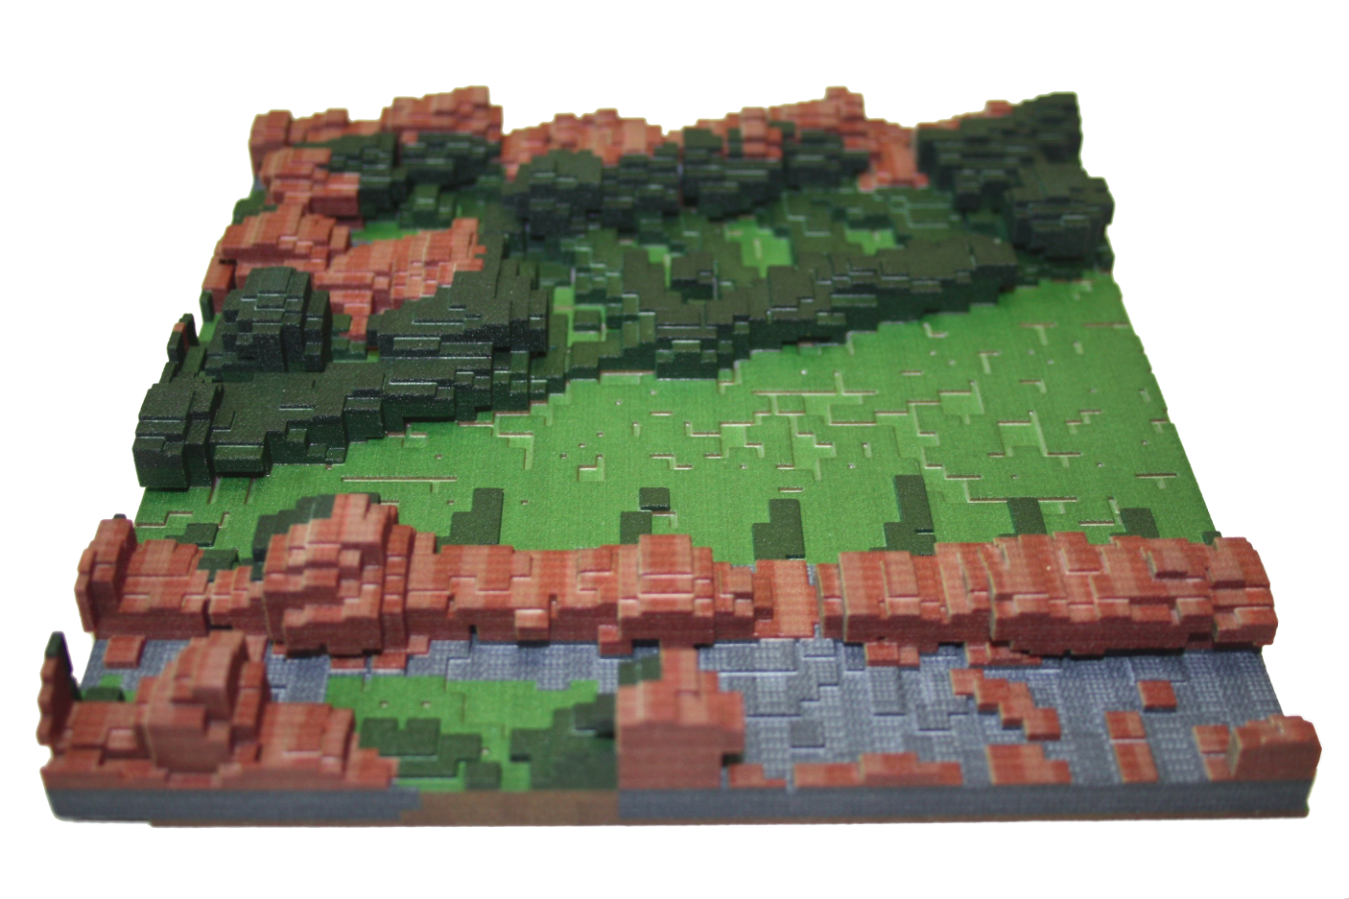
Notes:
<number>

Slide 22
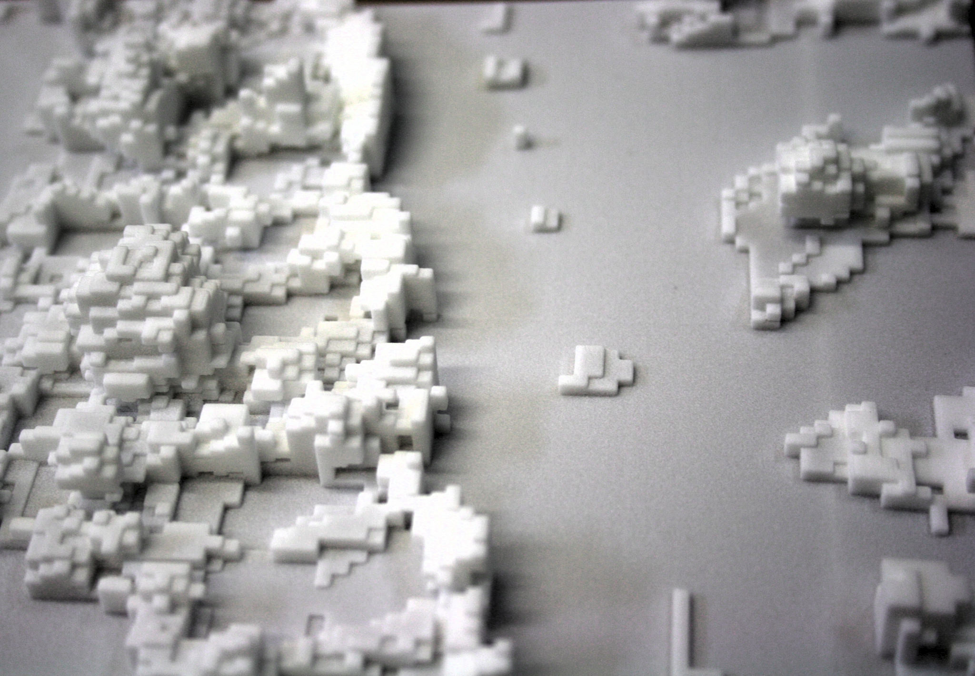
Notes:
<number>

Slide 23
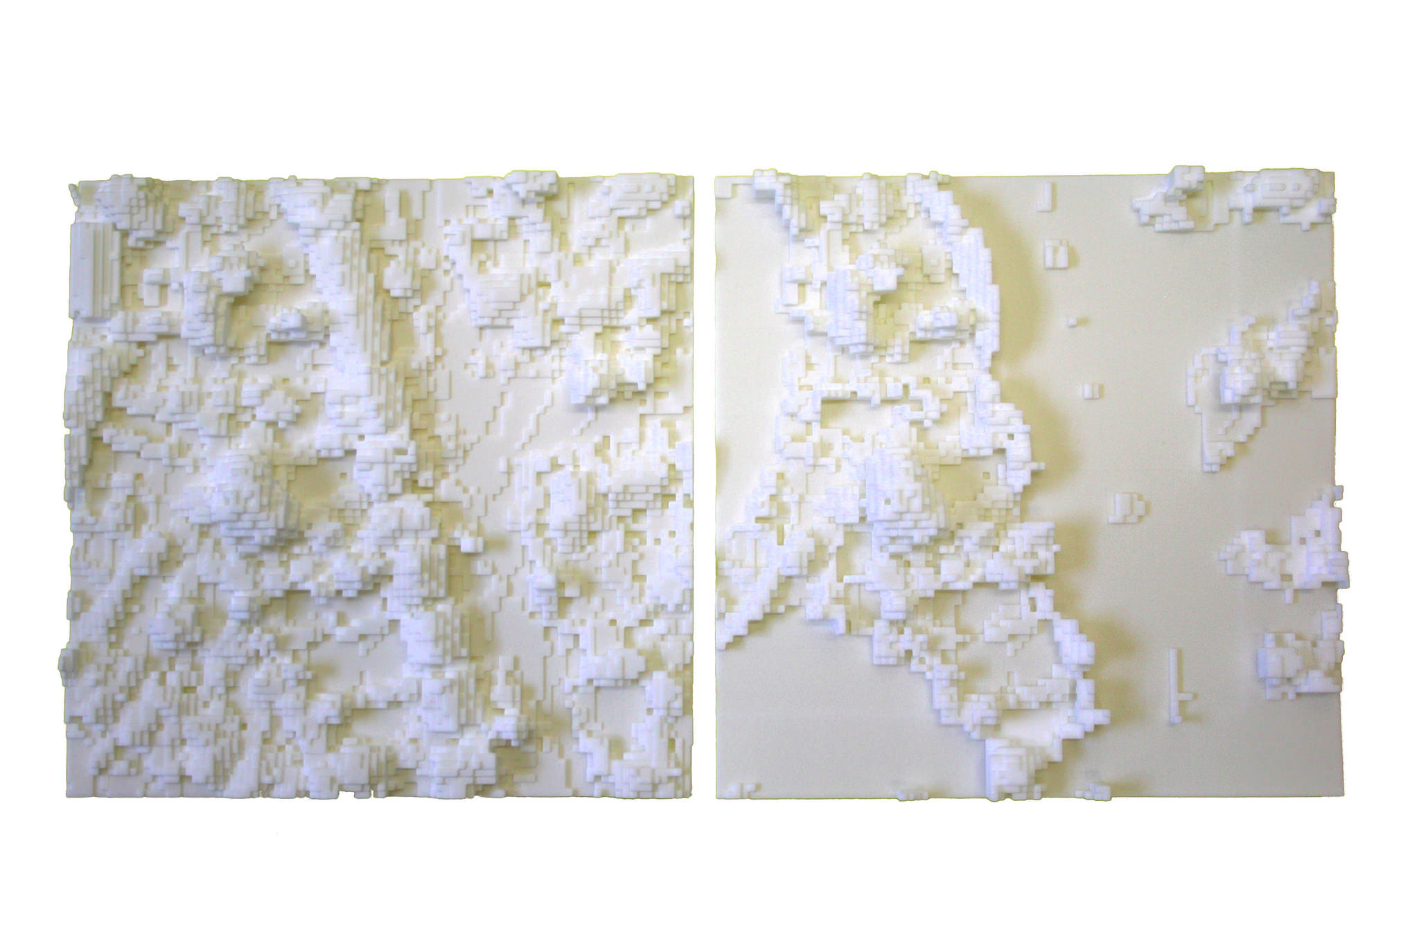
Notes:
<number>

Slide 24


A brief rant on the future of interaction design: Bret Victor 2011

Slide 25
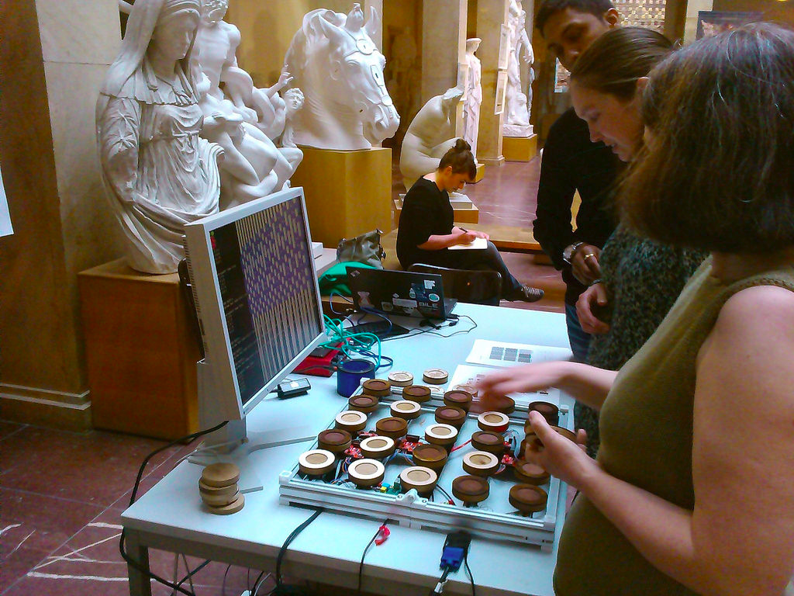



Slide 26
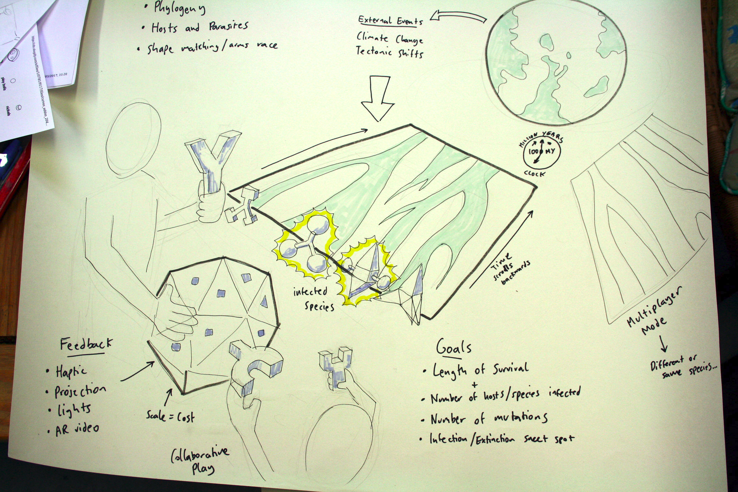

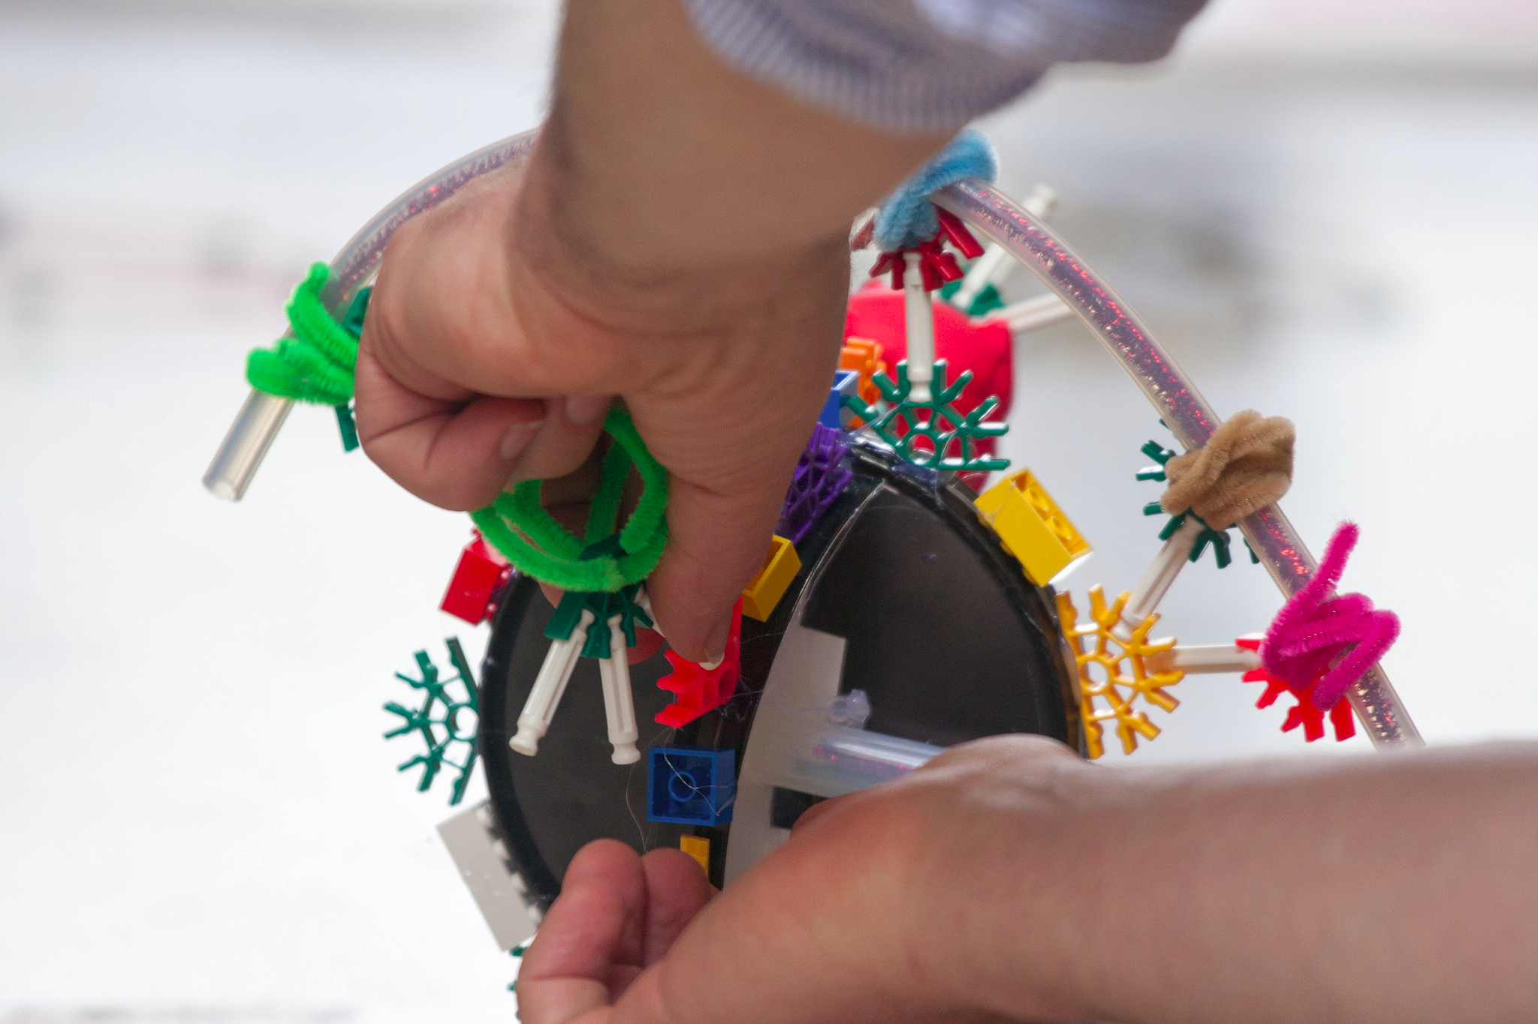
Viruscraft – Ben Longdon
(Exeter University)

Slide 27
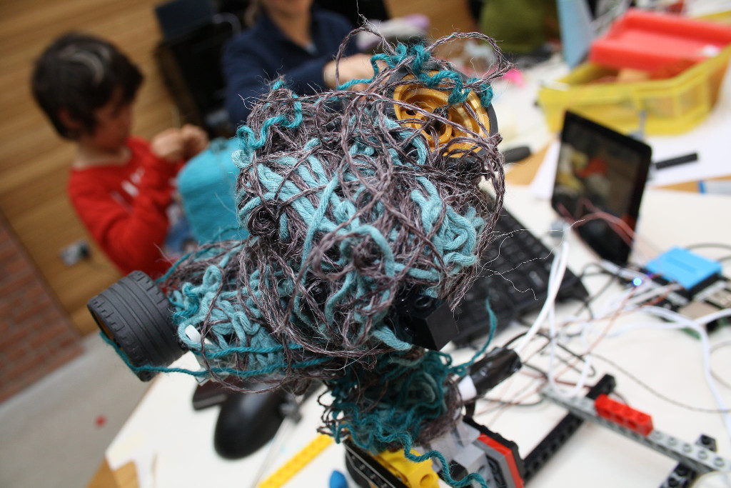

http://fo.am
kernow@fo.am
Notes:
<number>

Slide 28
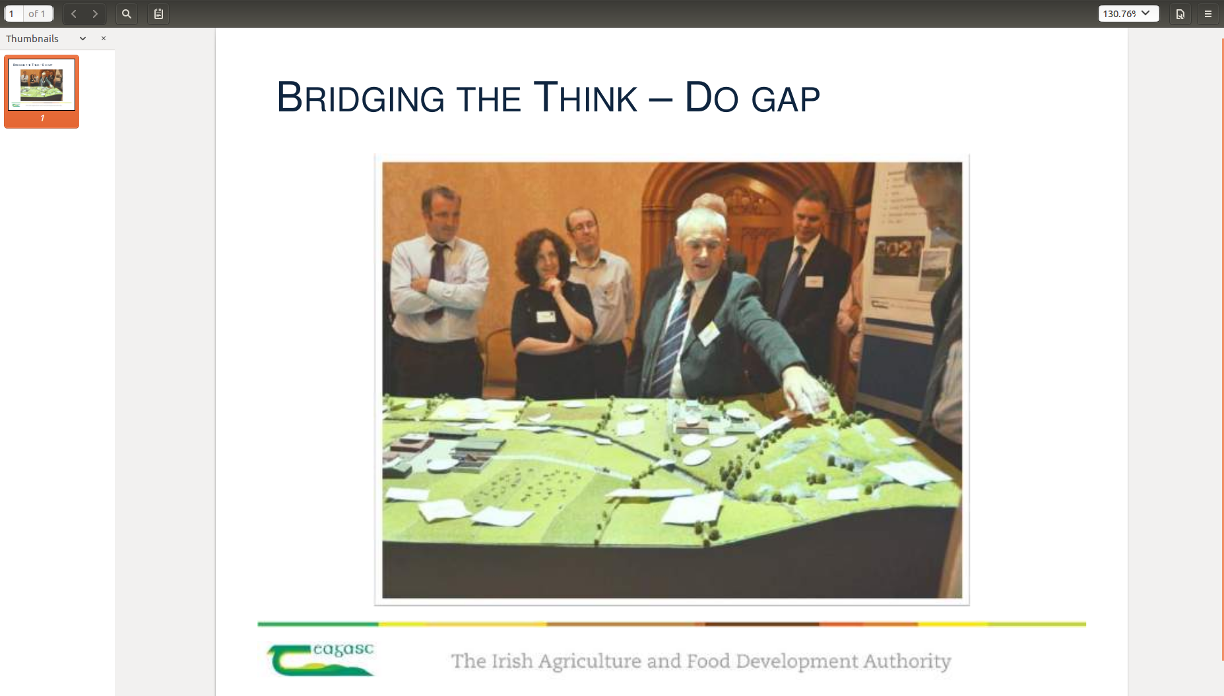
Notes:
<number>

Slide 29
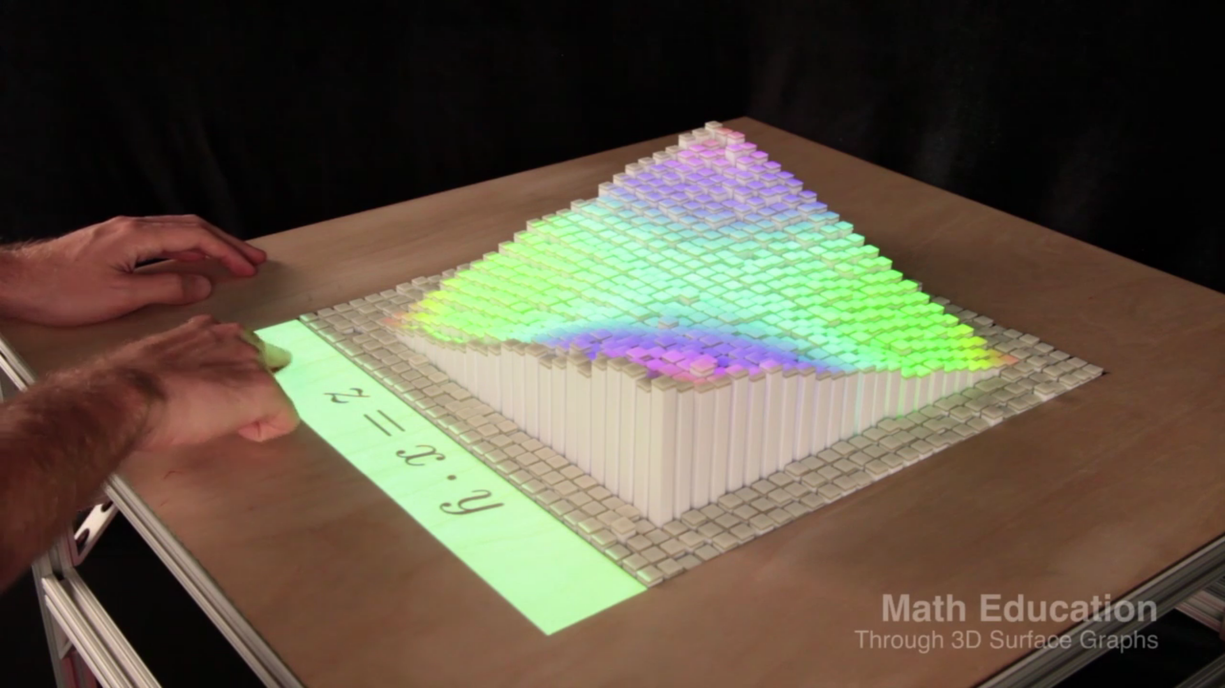
inFORM - Tangible Media Group @ MIT
Notes:
<number>

